Slide 1
Assignment two (Deep Learning)
Done By :
1- sara jehad alsanajleh (163418) .
2- ghada maher abu-shaqra (164188) .
supervisor : Rasha Obaiedat

Slide 2
Q1 – (a) What are the best number learning rate you obtained from tuning these hyperparameters ?
Learning Rate | Training Accuracy | Validation Accuracy | Testing Accuracy
0.001 | 90% | 78% | 76%
0.01 | 34% | 31% | 39%
0.1 | 32% | 34% | 31%
0 | 32% | 35% | 31%
1 | 33% | 34% | 30%
The best learning rate is 0.001 which resulted in:
Training Accuracy: 90%
Validation Accuracy: 78%
Testing Accuracy: 76%

Slide 3
Q1-(b) What are the best number epochs you obtained from tuning these hyperparameters ?
epochs | Training Accuracy | Validation Accuracy | Testing Accuracy
60 | 87% | 73% | 72%
30 | 84% | 75% | 72%
80 | 90% | 72% | 73%
100 | 91% | 73% | 73%
150 | 98% | 74% | 71%
The optimal number of epochs is 30 which achieved:
Training Accuracy: 84%
Validation Accuracy: 75%
Testing Accuracy: 72%

Slide 4
Q1- (c) What are the best number batch-Size you obtained from tuning these hyperparameters ?
Batch - Size | Training Accuracy | Validation Accuracy | Testing Accuracy
8 | 34% | 34% | 30%
16 | 82% | 71 % | 73%
32 | 83% | 72% | 75%
64 | 80% | 73% | 75%
The best number of batch-size is 64 which achieved:
Training Accuracy: 80%
Validation Accuracy: 75%
Testing Accuracy: 77%

Slide 5
Q1– (d) : What is the best testing accuracy corresponding to these values? Q1 – (e) : From monitoring the validation accuracy at each epoch, do you recommend using early stopping with low patience value (such as 2 for example) with learning rate 0.001? why?
Q1– (d) : the best testing accuracy corresponding to the optimal values (learning rate = 0.001, epochs = 30 , batch-size = 64) is 75%.
Q1 – (e) : Using early stopping with low patience is not recommended because validation accuracy fluctuates but improves overall in the long term.... Low patience may stop training prematurely. A higher patience value is better to capture the general trend.

Slide 6
Q2 – (a) : Train the model and report the validation and test accuracy
Dropout Configurations | Validation Accuracy | Testing Accuracy
Configuration 1 : dropout_fc=0.5, dropout_conv=0.0 | 73% | 77%
Configuration 2 : dropout_fc=0.3, dropout_conv=0.0 | 75% | 75%
Configuration 3 : dropout_fc=0.0, dropout_conv=0.3 | 71% | 70%
Configuration 4 : dropout_fc=0.0, dropout_conv=0.5 | 71% | 73%
Configuration 5 : dropout_fc=0.0, dropout_conv=0.0 | 73% | 74%

Slide 7
Q2 – (b) Compare the results of the five configuration.
Higher dropout in fully connected layers (Configuration 1): Applying a high dropout rate (0.5) in the fully connected layer achieves the good validation accuracy (73%), indicating strong regularization that prevents overfitting and improves generalization Moderate dropout in fully connected layers (Configuration 2): A lower dropout rate (0.3) in the fully connected layer achieves the highest validation accuracy (75%), showing balanced generalization and slightly better performance than Configuration 1.
Dropout in convolutional layers (Configurations 3 and 4): Applying dropout to convolutional layers (rates of 0.3 and 0.5) leads to a drop in validation accuracy (71%). This suggests that dropout negatively affects the model's ability to learn critical low-level features required for generalization
No dropout (Configuration 5): Without dropout, the model achieves moderate validation accuracy (73%) but is likely overfitting, as indicated by lower performance in generalization compared to Configuration 1 and 2.

Slide 8
Q2 – (c) : Discuss the effect of dropout on overfitting and generalization for the fully connected layer versus the convolutional layer . Q2 – (d) : Which configuration provides better generalization, and why? Q2 – (e) : analyze whether it is better to apply dropout to the low-level or high-level convolutional layers.
Q2 – (c) :
Fully Connected Layers: Dropout improves generalization and reduces overfitting by encouraging the network to learn robust patterns, as seen in Configurations 1 and 2.
Convolutional Layers: Dropout harms performance because it disrupts learning critical low-level features, leading to lower accuracy.
)Dropout works best in fully connected layers for preventing overfitting while maintaining good generalization.(
Q2 – (d) : Configuration 2 provides better generalization because it applies a moderate dropout rate (0.3) to the fully connected layer, which strikes a balance between preventing overfitting and allowing the model to learn effectively
Q2 – (e) : Applying dropout to low-level convolutional layers (early stages) harms performance because these layers extract essential features from the input data. Dropout in high-level convolutional layers might be slightly better but still disrupts feature extraction, as seen in Configurations 3 and 4.

Slide 9
Q2 – (f) : Highlight the advantages and disadvantages of each approach (dropping out low vs high level layers).
Dropout to Low-Level Layers
Advantages:
1- Helps Prevent Overfitting Early 2- Can Improve Generalization 3- Sometimes , Reduces Dependency on Low-Level Features
Disadvantages: 1- Hinders Learning of Essential Features 2- Slower Convergence 3- unable to capture the diversity of low-level patterns
Dropout to High-Level Layers
Advantages:
1- Effective Regularization 2- Maintains Low-Level Feature Learning 3- Improved Generalization
Disadvantages:
1- Loss of Complex Pattern Recognition
2- Potential for Underfitting

Slide 10
Q3 – What happens to the performance if you use the following filter configurations instead of the one described in the original architecture?
The original filter allows the network to capture more complex features as it goes deeper… the larger filter sizes in deeper layers contribute to learning detailed patterns improving performance without overfitting.
Configuration 1 (16,16,16 filters ) : the number of filters is fixed at 16 across all three convolutional layers..... this reduces the model's capacity to extract features, especially in the deeper layers…. the model struggles to generalize…. this is likely because the fixed, small number of filters limits the network’s ability to learn complex and diverse patterns, especially in deeper layers.
Configuration 2 (64,32,16 filters) : the initial high number of filters allows the model to capture more features in the first layer, the reduction in deeper layers likely limits its ability to learn complex features…which indicates weaker generalization.
filter_configs | Validation Accuracy | Testing Accuracy
[16,32,64] | 73% | 75%
[16,16,16] | 71% | 68%
[64,32,16] | 69% | 73%

Slide 11
Q4 – (a): What happens to the performance when using different pooling combinations compared to the original Max-Average pooling setup?
Avg, Max : Best training accuracy but may lead to slight overfitting due to the gap between training and validation accuracy.
Max, Max : Slightly worse training and validation accuracy, but test accuracy remains the same as Avg, Max.
Avg, Avg: Both training and validation accuracies drop, with the lowest test accuracy, which suggests that this combination may struggle with generalization compared to others.
original Max-Average pooling performs well with a balanced validation accuracy (73%).

Slide 12
Q4 - (b) : Provide the accuracy for each pooling combination and compare how different pooling strategies are, considering the following points: • Feature extraction (sharp vs. smooth features). • Generalization to unseen data. • Performance on the test set.
Pooling Type | Training Accuracy | Validation Accuracy | Testing Accuracy
Avg – Max | 81% | 73% | 75%
Max-Max | 83% | 72% | 75%
Avg – Avg | 80% | 71% | 74%
Pooling Strategy | Feature Extraction | Generalization to Unseen Data | Performance on the Test Set
Avg-Max | smooth features | Best generalization, highest validation accuracy | Consistent with validation, reliable generalization
Max, Max | Focuses on sharp, high-intensity features | Decent generalization, slightly lower validation accuracy | Good test accuracy
Avg-Avg | Captures smooth features, loses sharp details | Weak generalization due to over-smoothing | Poor test accuracy, weak feature extraction and generalization

Slide 13
Q5 – (a) : What happens to the performance when using different configurations for the fully connected layers compared to the original setup?
Original Setup: Provides the most balanced performance between training, validation, and test data. It achieves a validation accuracy of 73%.
[50]: Performs similarly to the original setup with a validation accuracy of 73.31%. This suggests a slight drop in generalization, but the test accuracy of 72.05% indicates it still generalizes well to unseen data
[128, 64]: Has the lowest validation accuracy at 71.28%, showing poorer generalization compared to both the original and [50]. This could indicate overfitting, where the model is too complex for the task, leading to worse generalization.

Slide 14
•Q5: 1- How does reducing the model's capacity to a single layer with fewer hidden nodes impact performance? Does this configuration result in underfitting or poor generalization?
fc_configs | Validation Accuracy | Testing Accuracy
50 | 73% | 72%
(128 , 64) | 71% | 73%
1- Reducing the model’s capacity to a single layer with fewer hidden nodes (50 configuration) results in a simpler model with fewer parameters to learn from the data. This can lead to underfitting, where the model struggles to capture the complexity of the data due to its limited capacity.
In the case of the [50] configuration, the validation accuracy is 73.31%, suggesting that the model is not underfitting significantly but still has a simpler structure, leading to slightly lower generalization compared to the original setup.

Slide 15
Q5 :
2- Does this setup improve accuracy and generalization compared to the simpler configuration?
When comparing the [50] configuration (val: 73.31%, test: 72.05%) with the original configuration (val: 73.29%, test: 71.28%), the simpler configuration ([50]) results in a slightly higher test accuracy (72.05% compared to 71.28%). However, the validation accuracy remains almost identical in both cases.
3- Discuss which configuration provides the best trade-off between computational efficiency and performance
The [50] configuration provides a better trade-off between computational efficiency and performance compared to the [128, 64] configuration. With fewer parameters, it requires less computational power and training time, making it more efficient. While the validation accuracy is slightly lower (73.31% vs. 73.29%) and the test accuracy is marginally higher (72.05% vs. 71.28%), the simpler model ([50]) achieves a similar performance with less complexity, making it a more computationally efficient choice than the more complex [128, 64] configuration.

Slide 16
Q6. Replace ReLU with tanh as the activation function in your best model configuration. Do you notice any drop in validation accuracy? Report the validation accuracy for both ReLU and Tanh configurations.
- Tanh Results: Validation Accuracy: 73% (average validation accuracy over 30 epochs) and Test Accuracy: 75%
- Relu Results: Validation Accuracy: 72 % (average validation accuracy over 30 epochs) and Test
Accuracy: 71%
During our experiments, we observed that the tanh activation function, which constrains outputs between -1 and 1, can provide more balanced outputs around zero. This characteristic is particularly useful for training on small datasets, as it helps the model converge more effectively. Additionally, tanh avoids the issue of "dead units" associated with ReLU, where neurons with negative inputs consistently output zero and stop learning.
However, despite these theoretical advantages, ReLU showed slightly better performance in our specific task. While the overall results with tanh were comparable, tuning revealed that ReLU produced better figure maps. Given ReLU’s superior performance in many practical applications, we ultimately decided to rely on it for this task. In general, ReLU remains a robust choice due to its simplicity and effectiveness, even if some scenarios might benefit from alternative activation functions like tanh.

Slide 17
Q7. Visualizing Convolutional Layer Feature Maps:
-Low-Level Features (conv1):
The first layer captures basic features like edges, gradients, and textures, resembling Gabor filters. These maps highlight areas with significant intensity changes, aligning with the theory of low-level feature detection.
-Mid-Level Features (conv2):
The second layer combines low-level features into more complex patterns such as shapes and contours. The feature maps outline object regions, indicating detection of mid-level features like simple object parts.
-High-Level Features (conv3):
The final layer captures abstract patterns, focusing on object-specific characteristics like textures or parts of objects. These maps are more uniform, emphasizing high-level feature abstraction

Slide 18
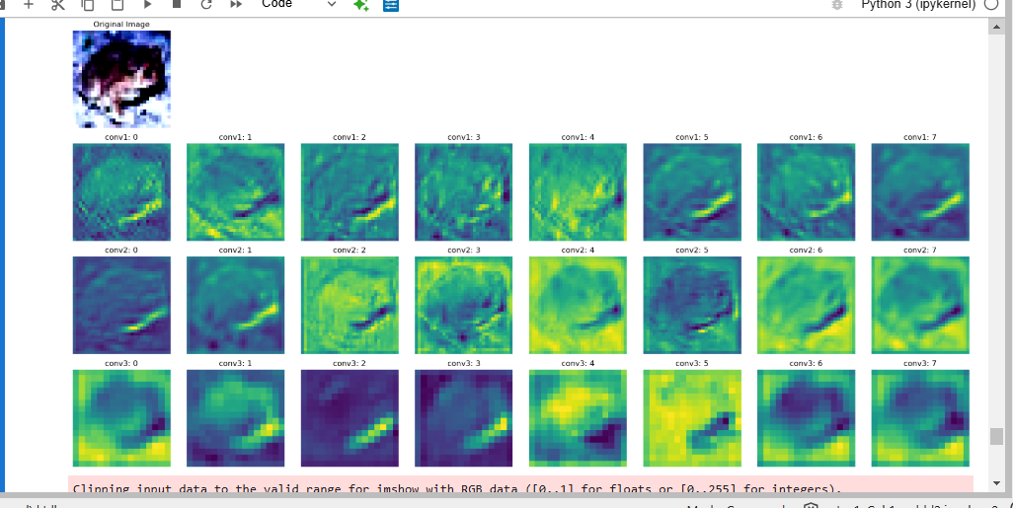
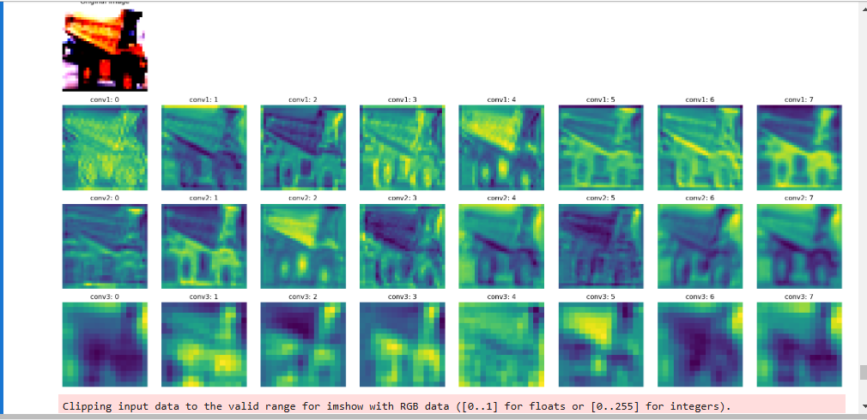
Q7. Feature Maps:

Slide 19
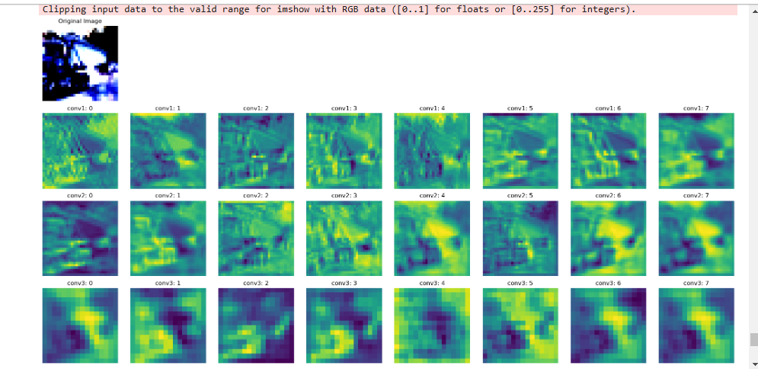
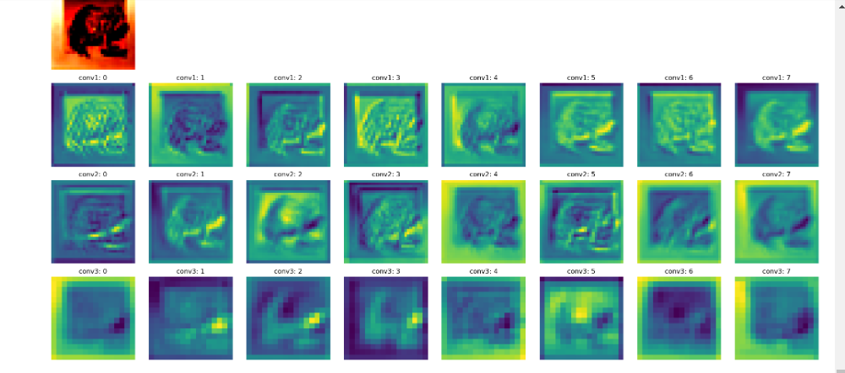
Q7. Feature Maps:

Slide 20
Bonus Question: Does increasing the number of classes create a harder classification task?
Yes, increasing the number of classes typically makes the classification task more challenging. This is because the model needs to learn more complex decision boundaries to distinguish between a larger number of categories. The observed results confirm this:
The results with 3-class:
Training Accuracy: 84%
Validation Accuracy: 75%
Testing Accuracy: 72%
The results with 5-class:
Training Accuracy: 71%
Validation Accuracy: 58%
Testing Accuracy: 58%
metric | 3-class-dataset | 5-class-dataset
Training Accuracy | 84% | 71%
Validation Accuracy | 75% | 58%
Testing Accuracy | 72% | 58%

Slide 21
Bonus Question :Does the larger number of classes require adjustments?
The drop in performance suggests that the model would benefit from several adjustments:
More Epochs: Training for more epochs could help improve accuracy, as the model may need additional time to converge on the more complex dataset.
Learning Rate: A lower learning rate might stabilize training and improve performance on the validation set.
More Filters/Additional Layers: Adding complexity to the model by increasing filters or layers can help capture finer details needed for distinguishing more classes.
Regularization and Data Augmentation: These methods can improve generalization and help combat overfitting, especially since the validation performance is lagging.

Slide 22
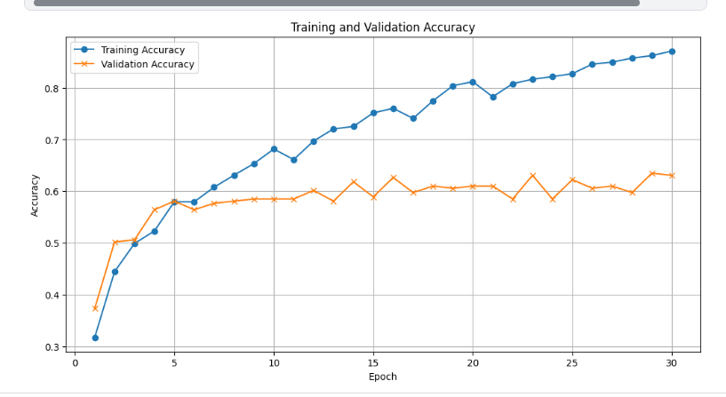
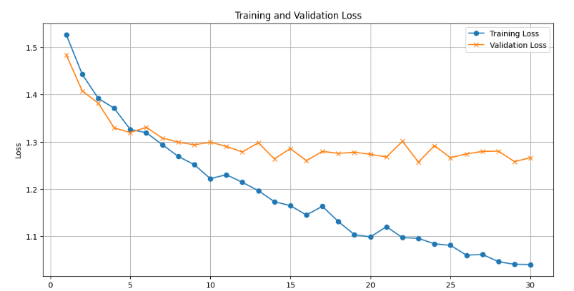
Bonus Question:charts

